Slide 1
AI-Based Image Caption Generator
Sample Project Presentation
Using CNN + RNN with Python, TensorFlow, and Flask
Name: Vennela Boinapalli
Intern id: EX-1753693472398

Slide 2
Introduction
This project aims to develop an AI-based Image Caption Generator system that automatically generates descriptive captions for images by combining computer vision and natural language processing.
It leverages:
- CNNs for image feature extraction
- RNNs/LSTMs for caption generation
- Pre-trained models for faster and accurate results

Slide 3
Project Objectives
1. Automate image captioning using AI techniques.
2. Learn encoder-decoder architectures for CV + NLP tasks.
3. Use pre-trained CNN models for feature extraction.
4. Train and fine-tune RNN-based language models.
5. Deploy the model as an API using Flask.

Slide 4
Dataset
Dataset Used: MSCOCO (Microsoft Common Objects in Context)
- Contains 300K+ images with 5 captions per image
- Each caption describes the content of the image
- Images are preprocessed and converted into features using a pre-trained CNN model.

Slide 5
Model Architecture
The model follows an Encoder-Decoder architecture:
• Encoder: Pre-trained CNN (e.g., InceptionV3/ResNet50) to extract image features.
• Decoder: RNN/LSTM network to generate captions based on image features.
• Embedding Layer for word vectors.
• Uses attention mechanism for better caption generation.

Slide 6
Training Process
1. Extract image features using a pre-trained CNN.
2. Tokenize and preprocess captions.
3. Train the Encoder-Decoder model on the MSCOCO dataset.
4. Fine-tune RNN layers for better accuracy.
5. Optimize using cross-entropy loss and Adam optimizer.

Slide 7
Evaluation Metrics
To evaluate the quality of generated captions, we use:
• BLEU Score (Bilingual Evaluation Understudy)
• METEOR Score (Metric for Evaluation of Translation)
• CIDEr and ROUGE metrics for additional evaluation.

Slide 8
Deployment
The trained model is deployed as a REST API using Flask:
• User uploads an image.
• API extracts image features using CNN.
• RNN-based decoder generates captions.
• Caption is returned as JSON response.

Slide 9
Tools & Technologies
Programming Languages:
• Python
Libraries & Frameworks:
• TensorFlow / PyTorch
• OpenCV
• NLTK / SpaCy
• Flask
Dataset:
• MSCOCO Dataset
Visualization:
• Matplotlib, Seaborn

Slide 10
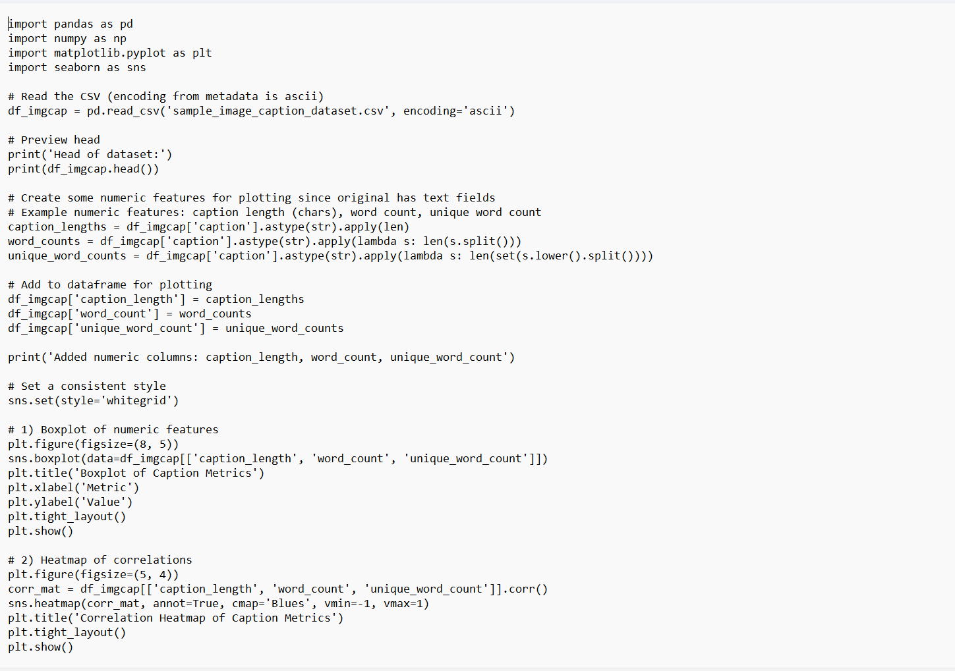

Slide 11
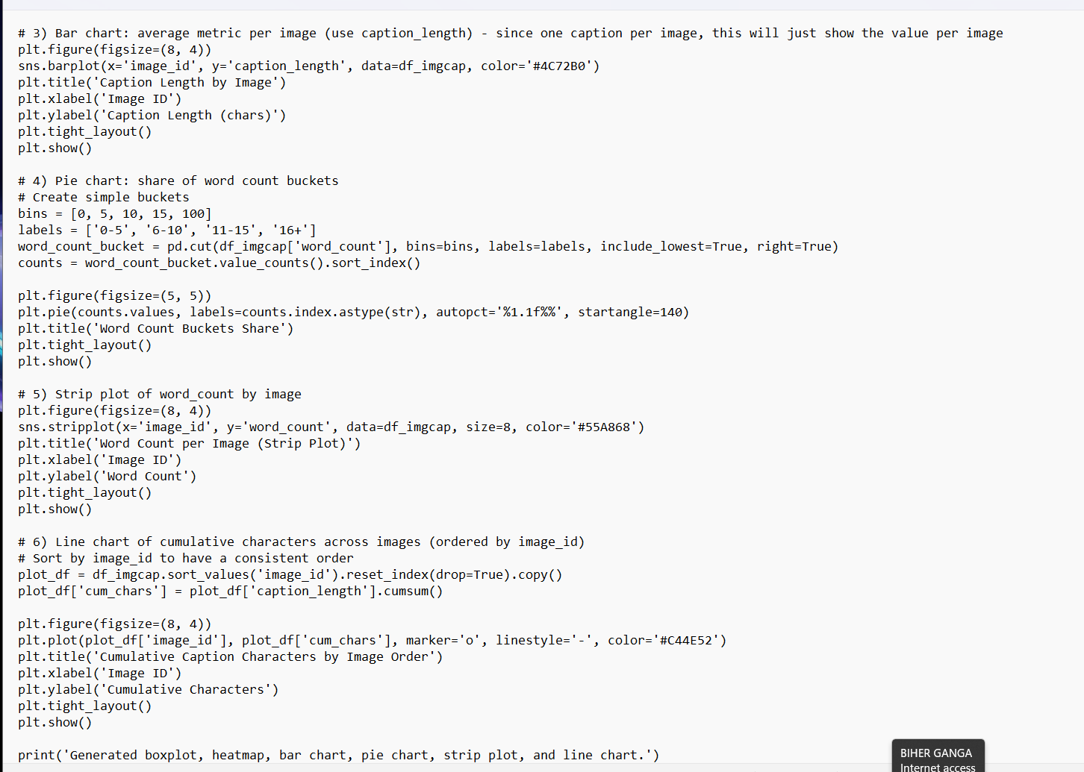

Slide 12
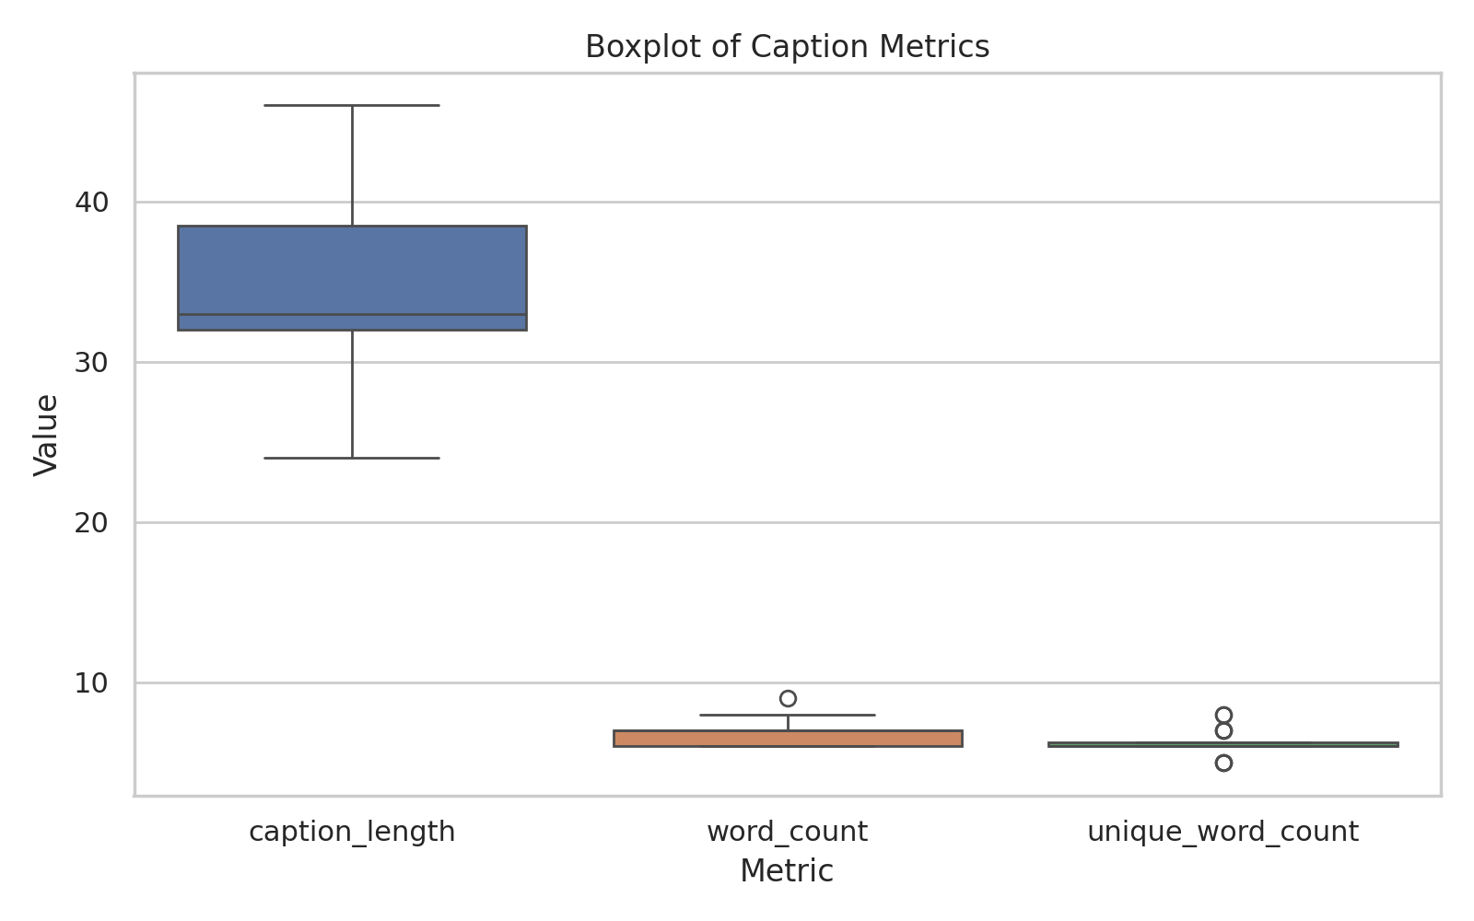
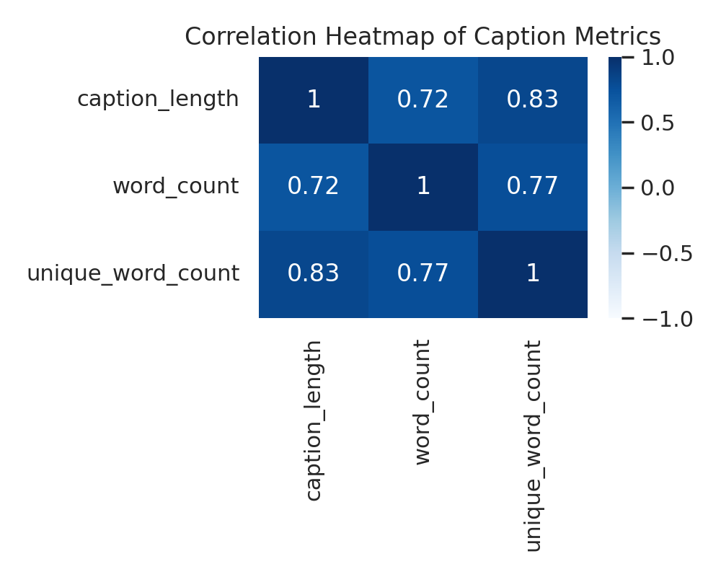
Box plot
Heat map

Slide 13
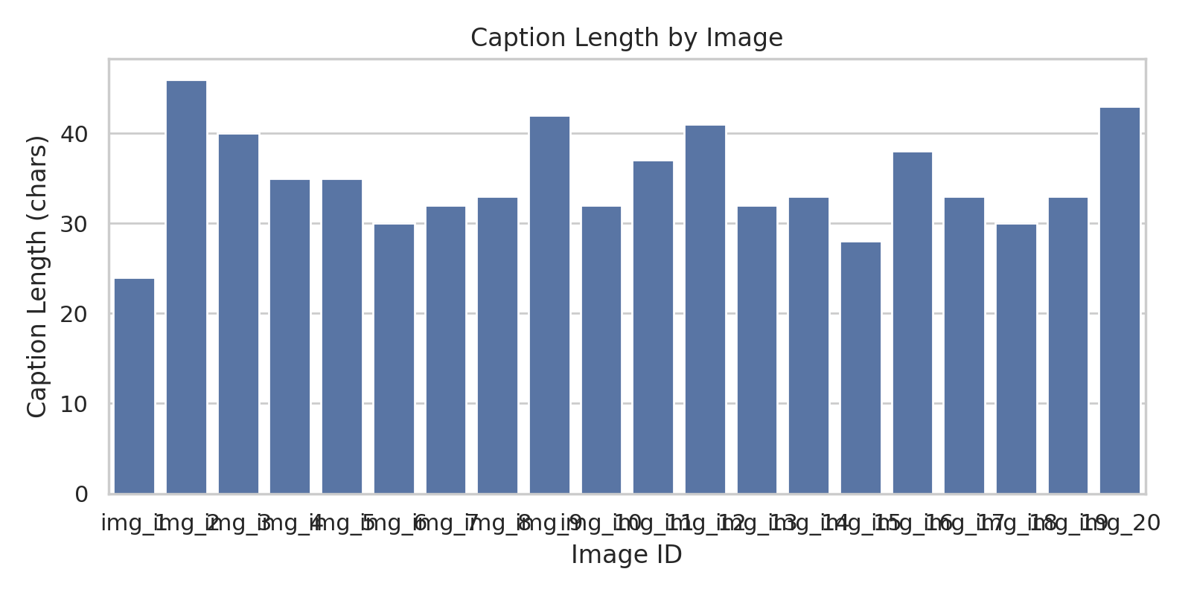
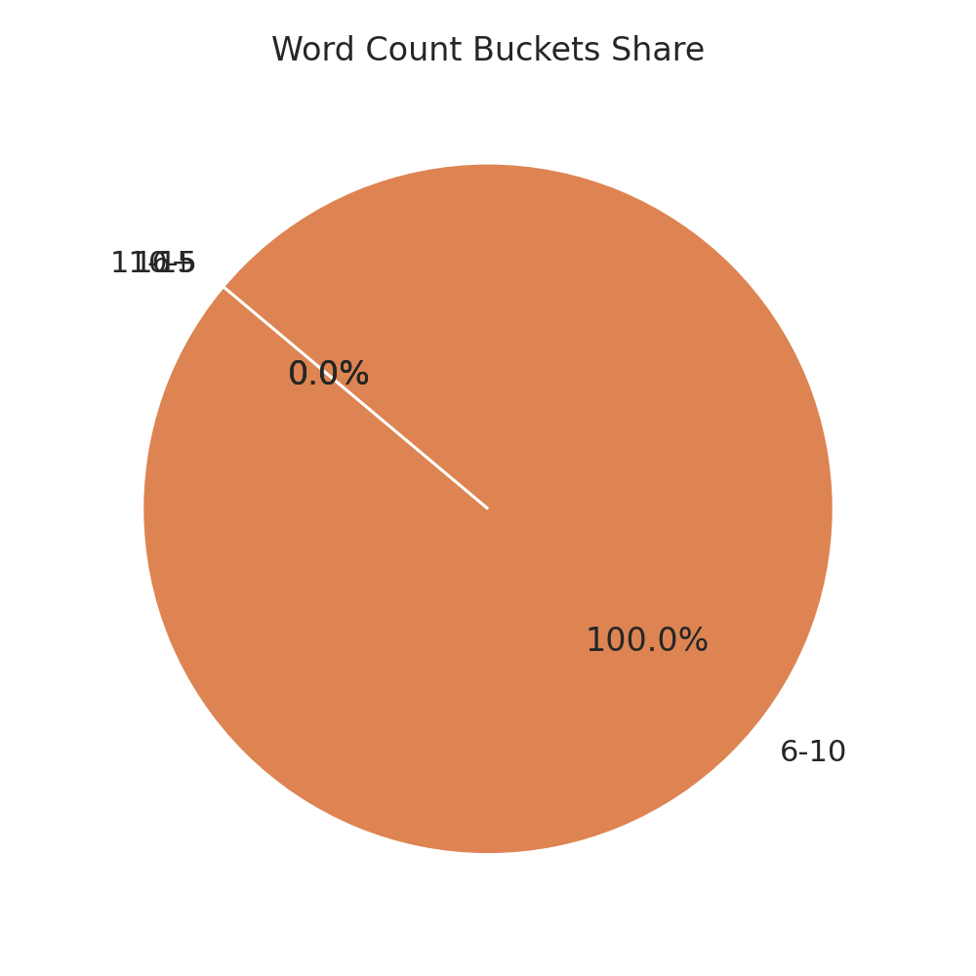
Bar chart
Pie chart

Slide 14
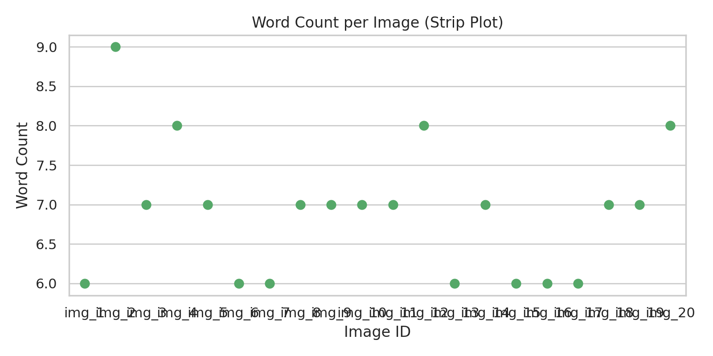
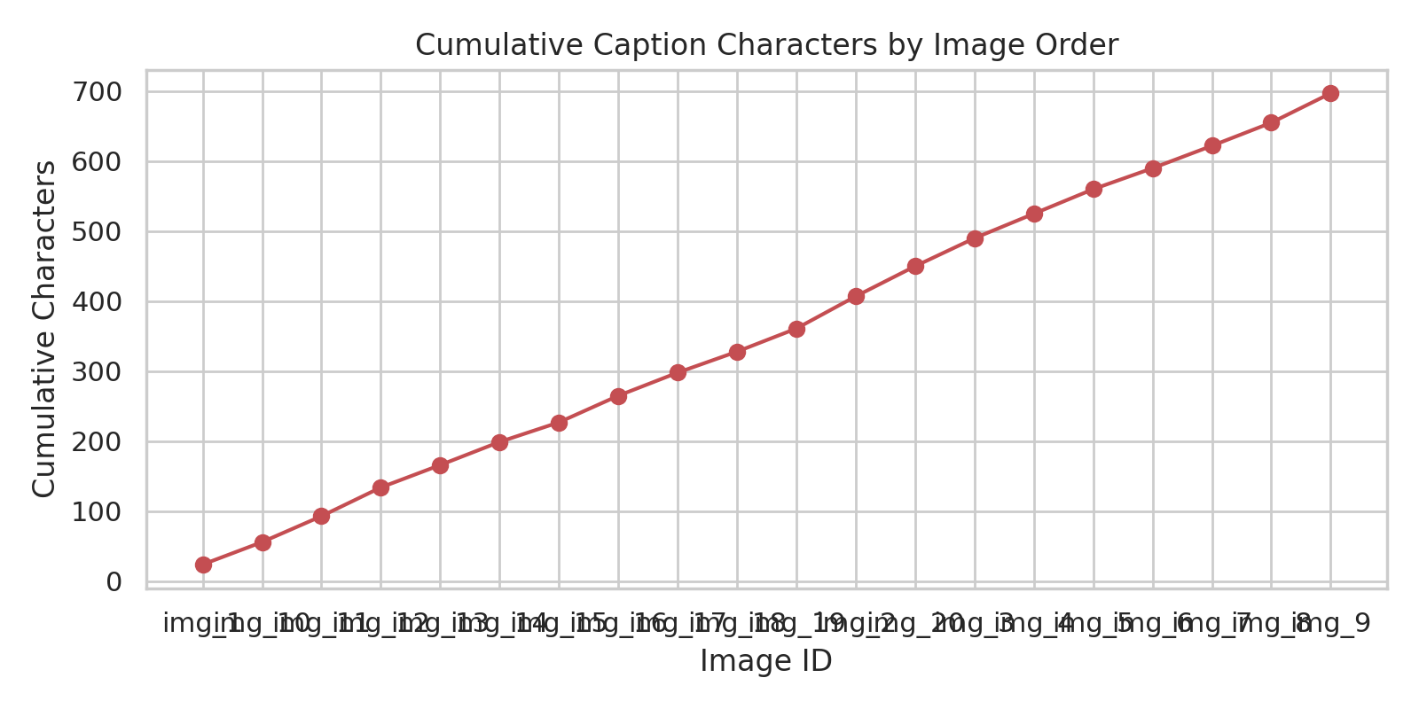
Strip plot
Line chart

Slide 15
Conclusion
• AI-based image captioning automates the task of describing images.
• Combines the power of CNNs and RNNs for computer vision and NLP.
• Achieves accurate captions using pre-trained models.
• Can be integrated into apps, websites, and AI-based systems.

